Slide 1
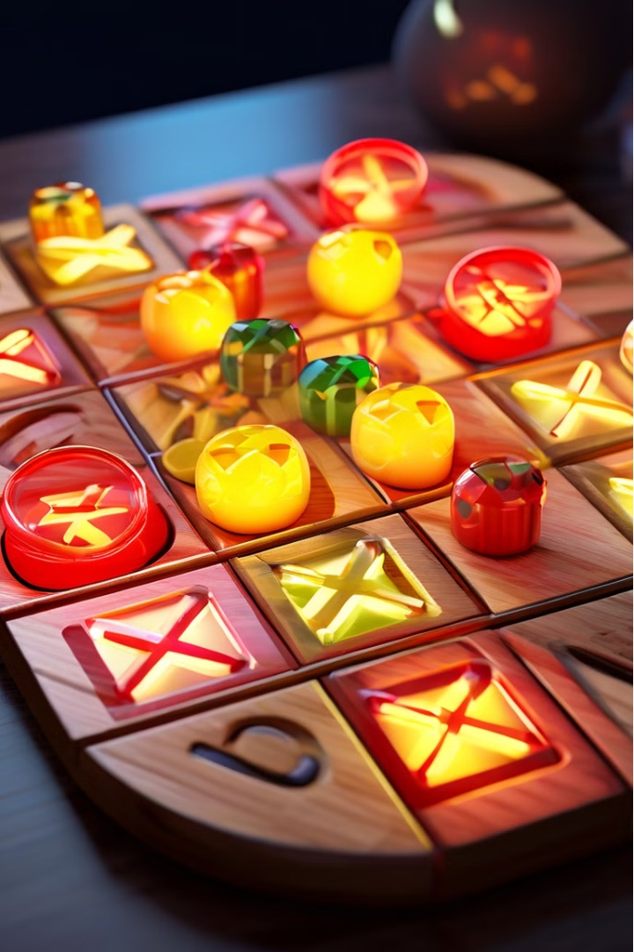

Introduction to Tic Tac Toe
The program describes a basic game of Tic Tac Toe! Discover the beauty of this timeless paper-and-pencil game as we guide you through the fundamentals of creating your own version using Python programming. From the straightforward rules to the mind-bending strategies, prepare to be captivated by the simplicity and challenge of Tic Tac Toe.

Slide 2
Python Programming Fundamentals
1
Variables and Data Types
2
Control Structures
Understand how to declare and use variables to store game data.
Learn to implement conditional logic and loops for game flow.
3
Functions and Modules
4
Input/Output
Organize your code into reusable functions and modules.
Handle user input and display game information to the player.

Slide 3
Tic Tac Toe Board Representation
Data Structure
Indexing
Choose an appropriate data structure, such as a list or a 2D array, to represent the game board.
Understand how to access and update individual cells on the board using indexing.

Slide 4
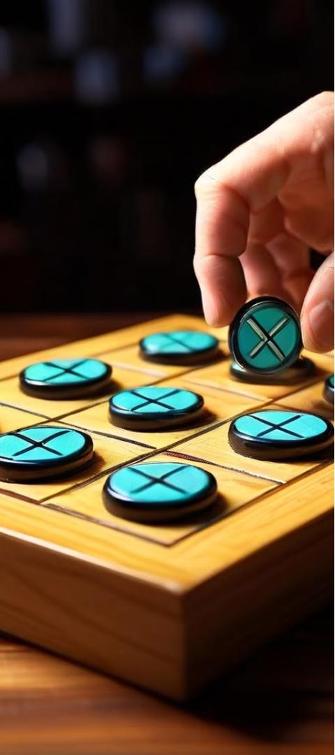
Player Input and Validation
1
Receiving Input
Prompt the player to enter their move and capture the input.
2
Validation
Check if the player's move is valid, such as ensuring the selected cell is empty.
3
Error Handling
Handle invalid inputs gracefully and prompt the player to try again.

Slide 5
Game Logic and Flow
Turn Management
Win Conditions
Keep track of whose turn it is and switch between players.
Implement the logic to check if a player has won the game.
Tie Condition
Board Updates
Detect when the game is a tie and handle the outcome accordingly.
Update the game board to reflect the players' moves.

Slide 6


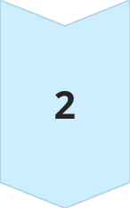
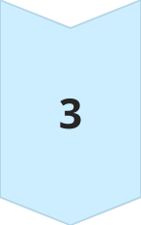
Implementing the Game Loop
Player Turn
Allow the current player to make a move.
Board Update
Update the game board to reflect the new move.
Game State Check
Determine if the game has been won, lost, or resulted in a tie.

Slide 7

Conclusion
The development of the Tic Tac Toe game in Python has been a rewarding and educational experience. Through this project, we have successfully implemented a classic game using fundamental programming concepts and techniques.

